Slide 1
MNIST HANDWRITTEN DIGIT CLASSIFICATION
Internship Project at Neurons Solution
Artificial Intelligence (Robotics)
Group#: 1
Group Members:
Sana Akbar
Ubaida Waheed
Muneeba Mehmood
Shehla Ibrar

Slide 2
Table Of Contents:
Introduction
MNIST Handwritten Digit Classification
Algorithm we used
Dry run of Algorithm
Tools & Technologies used
Output screenshot of final result
YouTube Video Link
Conclusion

Slide 3
Introduction:
Humans can visually sense the world around them by using their eyes and brains. Computer visions work on enabling computers to see and process images in the same way that human vision does. There are many algorithms that are developed in the field of computer vision to recognize images.
The goal of this work is to create a model to identify and determine the handwritten digits from its data sets with better accuracy and aim to complete this by using the concepts of Convolutional Neural Network and MNIST dataset.
Utilizing these deep learning techniques, a high amount of accuracy can be obtained in recognizing handwritten digits. This technique can be used to make the model test with the robotics or in creating artificial brain.

Slide 4
MNIST Handwritten Digit Classification:
The acronym stands for “Modified National Institute of Standards and Technology”.
MNIST is a built-in dataset provided by Keras., a library of deep learning.
MNIST dataset has a training set of 60,000 examples and a test set of 10,000 examples.
All the grayscale images of handwritten single digits between 0 and 9 in the dataset are of 28 ×28 pixels.
Training of the network is done by this dataset.

Slide 5
Algorithm we used:
Adam Optimizer Algorithm is used. We used Adam optimizer algorithm because of its following features:
Straightforward to implement.
Computationally efficient.
Little memory requirements.
Faster computation time.
Hyper-parameters have intuitive interpretation and typically require little tuning.

Slide 6
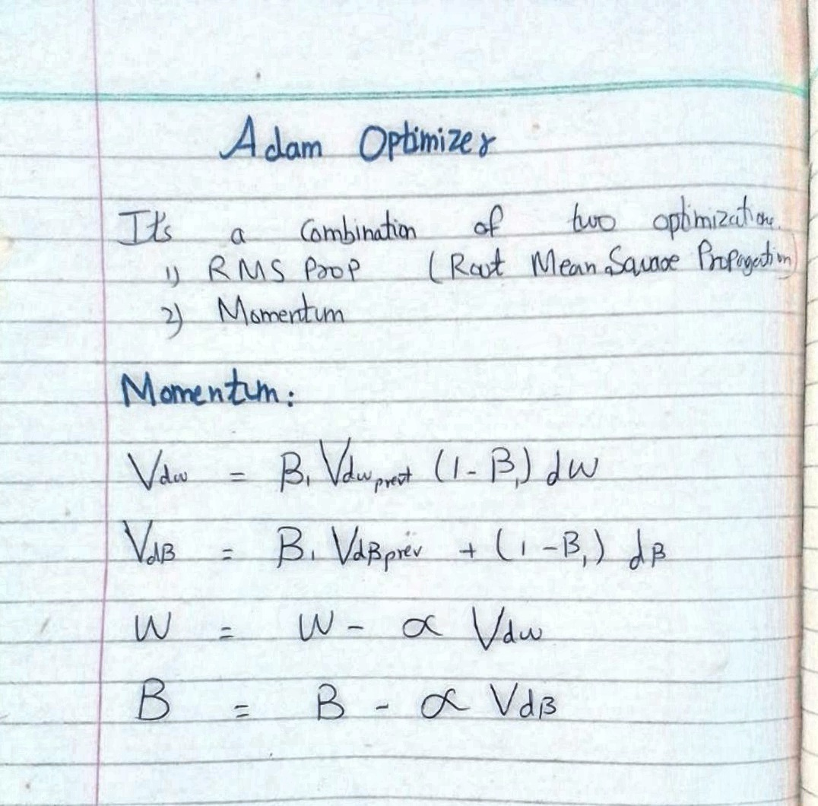
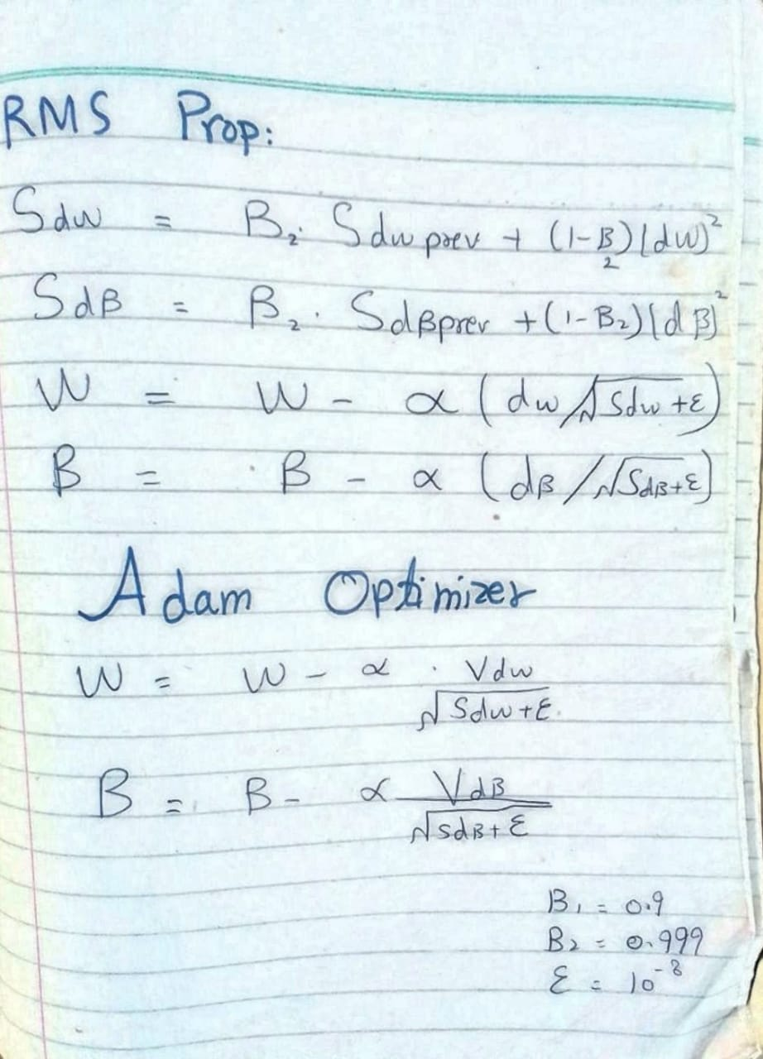
Dry run of algorithm:

Slide 7
Tools & Technologies:
Libraries:
TensorFlow, NumPy, Keras.
Tools:
Anaconda, PyCharm, Jupiter Notebook, Visual Studio Code, Google Browsers.
Language:
Python.
Frontend:
Streamlit. It is an open-source app framework in Python language.

Slide 8
Output screenshot of final output:

Slide 9
YouTube Video Link:
https://youtu.be/oUFQaCXrTQ8

Slide 10
Conclusion:
We have demonstrated a model which can recognize handwritten digit. Later it can be extended for character recognition and real-time person’s handwriting. The results can be made more accurate with more convolution layers and a greater number of hidden neurons. It can completely abolish the need for typing. Digit recognition is an excellent prototype problem for learning about neural networks and it gives a great way to develop more advanced techniques of deep learning.

Slide 11
THANK YOU ☺

